Slide 1
CONVOLUTIONAL NEURAL NETWORK

Slide 2
What Is CNN
Convolutional neural networks or CNNs, are a specialized kind of neural network for processing data that has a known grid-like topology.
Convolutional neural networks are widely used in computer vision and have become the state of the art for many visual applications such as image classification.
CNN is a feedforward neural network is one of the simplest types of artificial neural networks devised. In this network, the information moves in only one direction—forward—from the input nodes, through the hidden nodes (if any), and to the output nodes. There are no cycles or loops in the network

Slide 3
Layers Of CNN
Convolutional Layers - Convolutional layers are the core building blocks of CNNs. They perform a series of convolution operations on the input data using learnable filters or kernels. These filters slide over the input data to detect patterns, edges, and features. The result is a set of feature maps that represent the presence of specific features in the input.
Activation Function (e.g., ReLU) - After each convolution operation, an activation function is applied element-wise to introduce non-linearity. Rectified Linear Unit (ReLU) is a commonly used activation function in CNNs.
Pooling Layers - Pooling layers (e.g., MaxPooling or AveragePooling) are used to down-sample the spatial dimensions of the feature maps while retaining important information. Pooling helps reduce the computational complexity and makes the network more robust to variations in the input.

Slide 4
Flatten Layer - The flatten layer is used to convert the multi-dimensional feature maps into a one-dimensional vector. This is necessary when transitioning from convolutional layers to fully connected layers.
Fully Connected Layers (Dense Layers) - Fully connected layers connect every neuron in one layer to every neuron in the next layer. These layers are responsible for combining high-level features and making final predictions.
Note - For hidden layers in neural networks, ReLU is often preferred due to its faster convergence and ability to handle the vanishing gradient problem whereas For binary classification problems, especially in the output layer, where the goal is to predict probabilities, sigmoid is commonly used

Slide 5
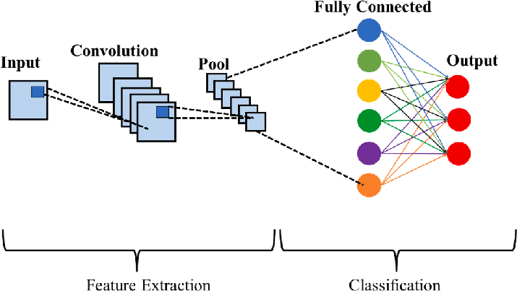
CNN ARCHITECTURE

Slide 6
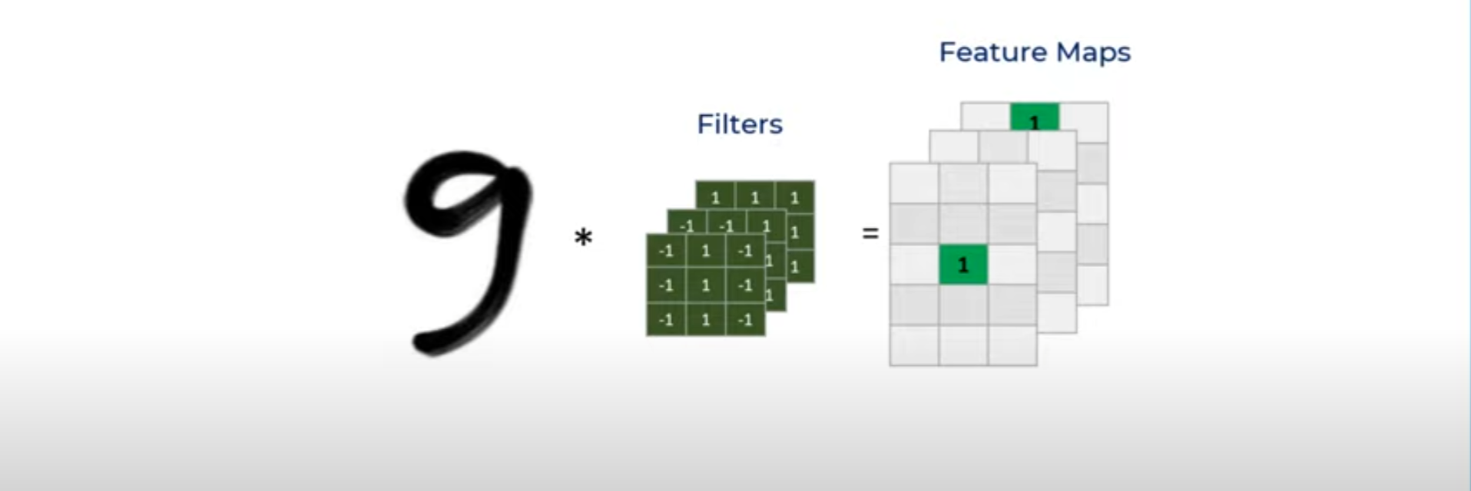
CONVOLUTIONAL

Slide 7
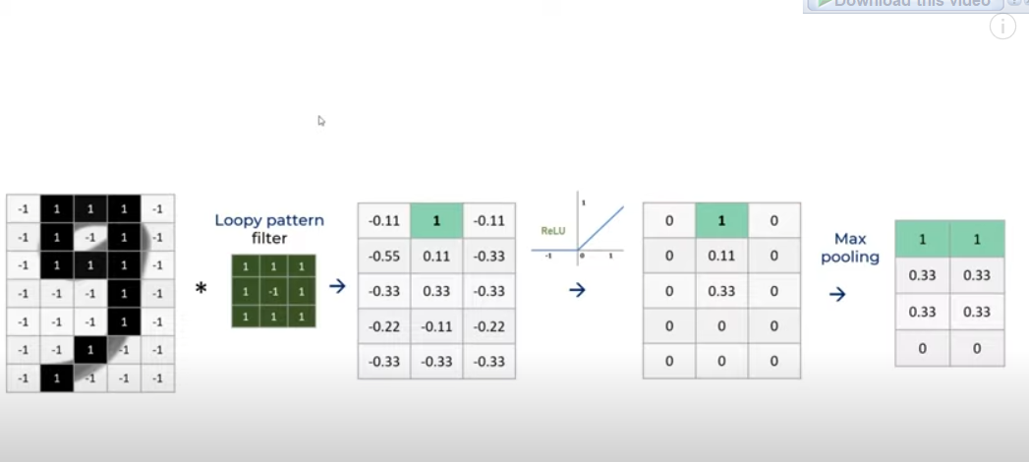
Code Visualization

Slide 8
Key Terminology
Adam - Adam (short for Adaptive Moment Estimation) is an optimization algorithm that combines ideas from two other popular optimization algorithms, namely, RMSprop (Root Mean Square Propagation) and Momentum.
sparse_categorical_crossentropy - 'Sparse' indicates that the labels are provided as integers (class indices), not one-hot encoded vectors. In other words, if you have classes labeled as 0, 1, 2, ..., N-1,

